Slide 1
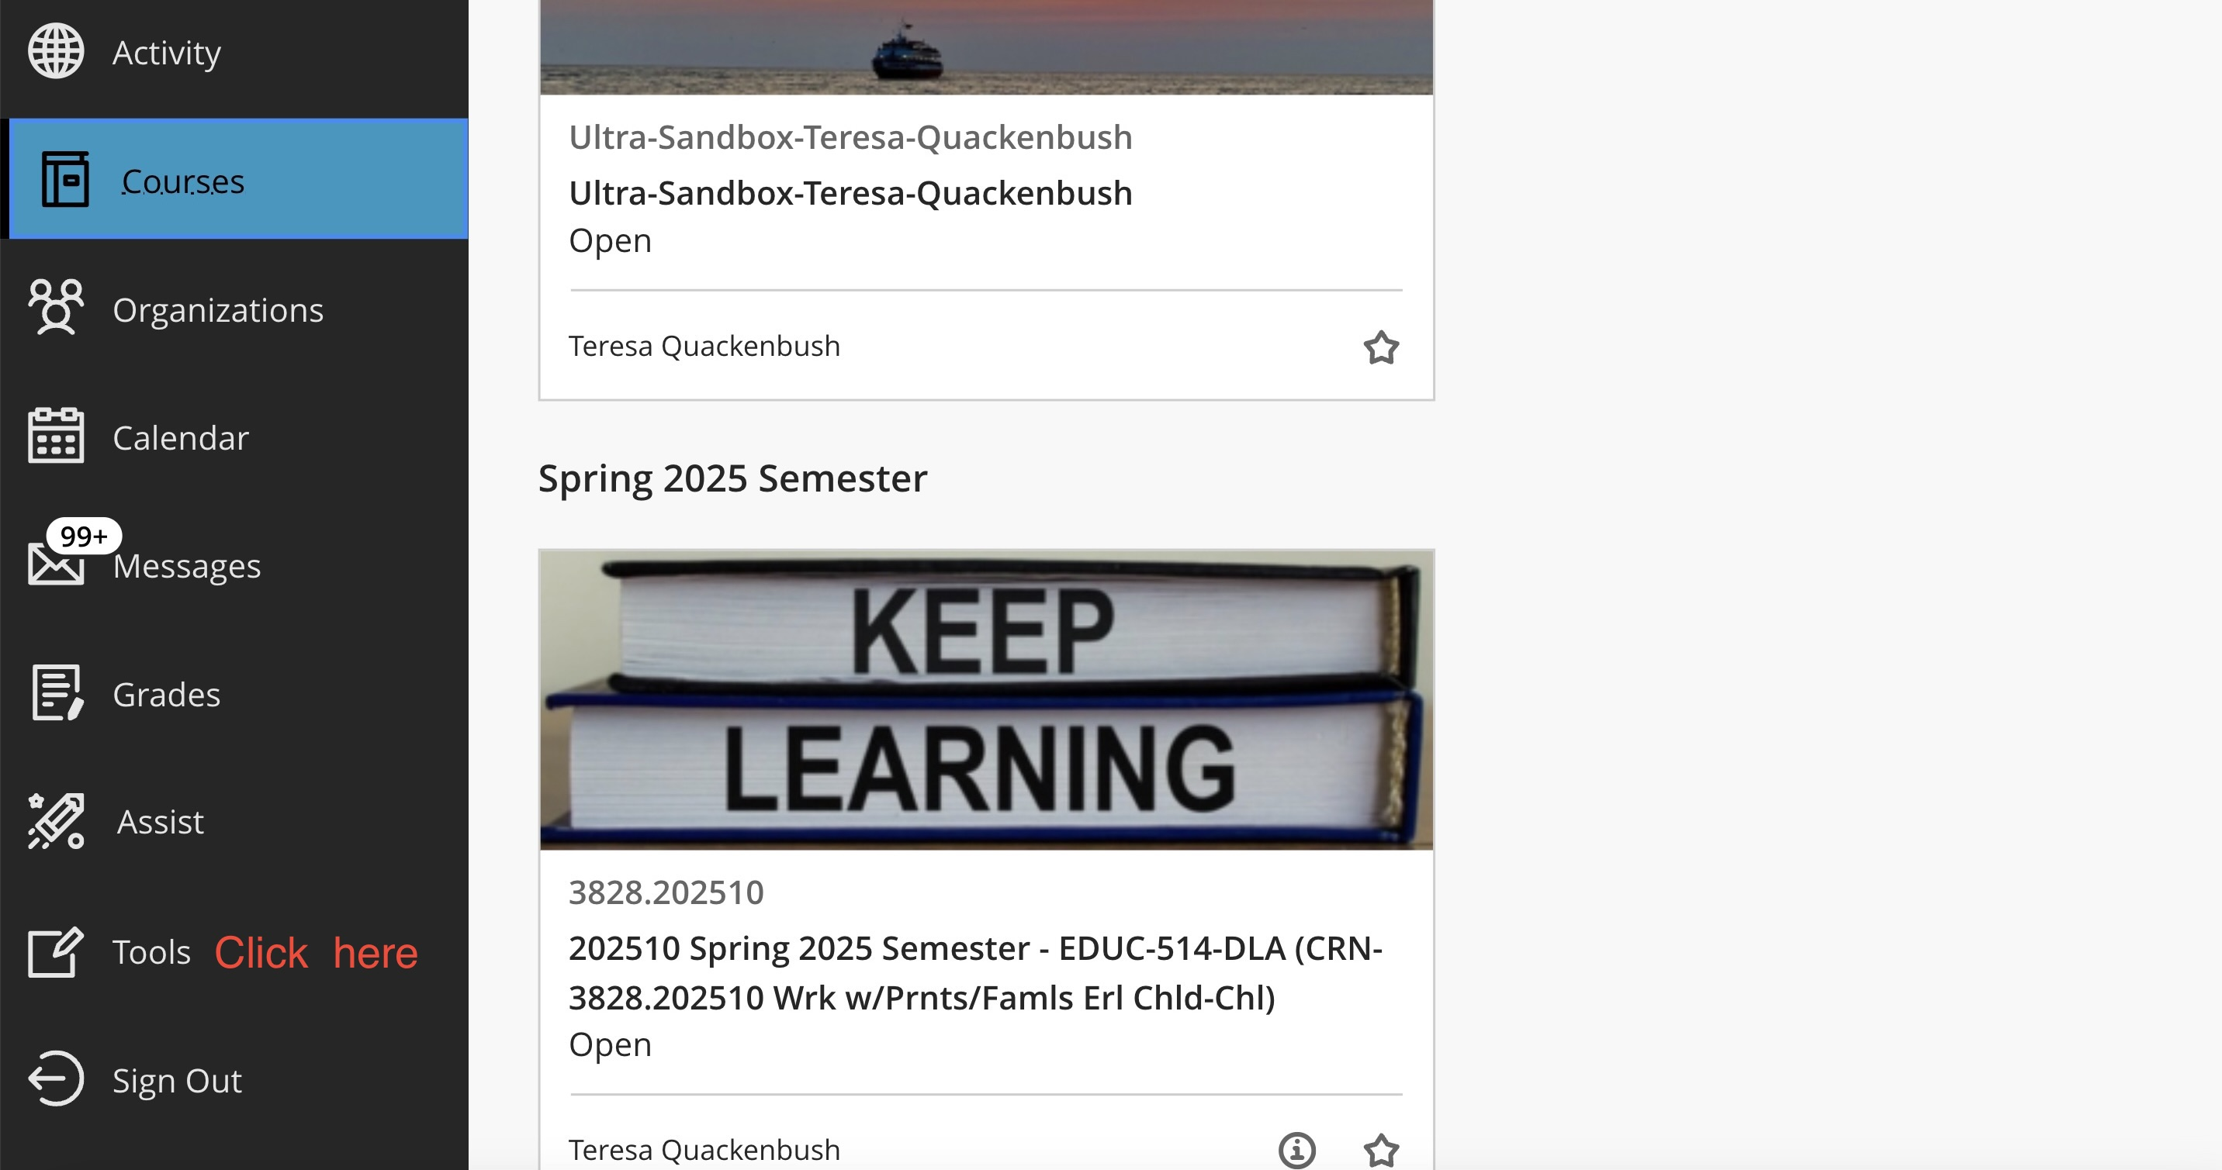

Log into you Blackboard and click on “TOOLS” on the left menu in BB

Slide 2
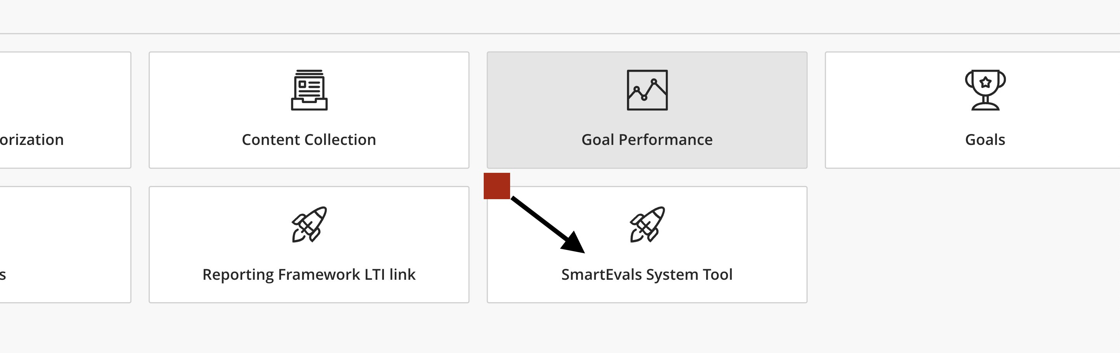
Click on the SmartEvals System Tool

Slide 3
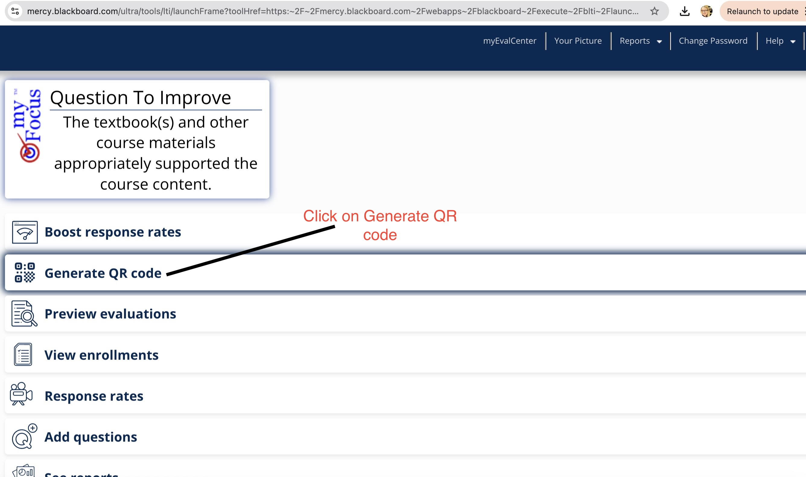
Click on “Generate QR Code”

Slide 4
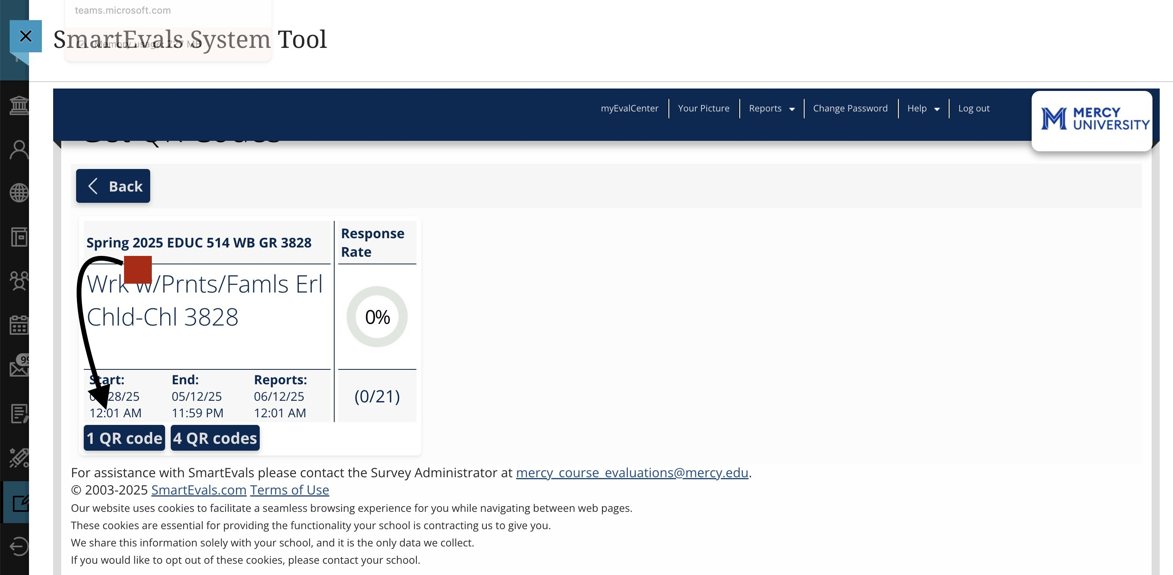
Click on the blue tab: 1 QR code

Slide 5
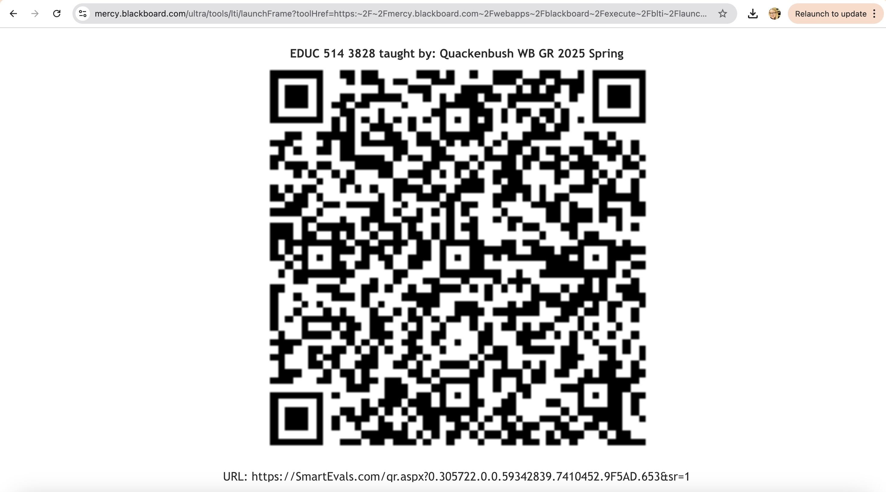
Cut and paste the eval QR code for your course and link into your course for students to complete-let’s reach 100%!

